Slide 1
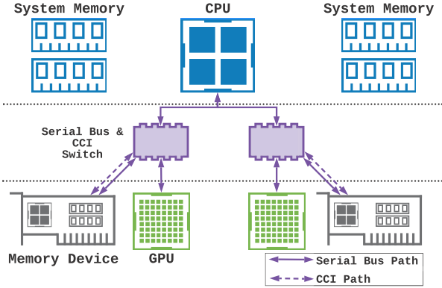
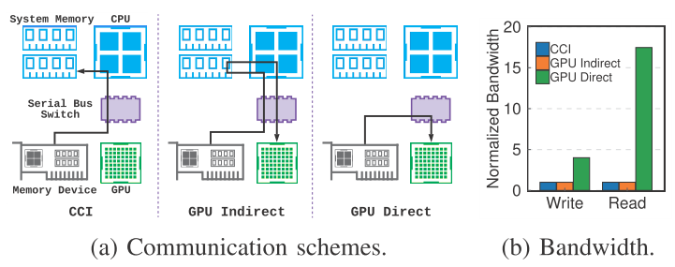
HPCA 2022: Enabling Efﬁcient Large-Scale Deep Learning Training with Cache Coherent Disaggregated Memory Systems
^{[M.1]}
I. Background Information and Challenges
III. Solutions
In distributed DL training, parameter communication became a key performance bottleneck.
GPUs and TPUs on-device memory is high-performance but significantly smaller than the system memory; on-device memory capacity does not evolve as fast as DL model sizes.
The bandwidth of cross-device communication is significantly lower than on-device memory bandwidth.
Cache-coherent interconnection (CCI): allows CPU to directly issue load and store instructions to access multiple memory devices attached to the existing serial buses; CCI also allows the host CPU to distribute memory-intensive computation jobs to the processors on memory devices, schedule the jobs, and collect computed results.
CCI reuses existing serial bus physical layer protocol and builds a customized higher-level protocol stack that focuses on improving ﬁne-grained memory access latency while providing sufﬁcient peak bandwidth. Thus, CCI can achieve higher bandwidth when accessing small memory blocks.
COARSE: a disaggregated memory extension for parameter communication in distributed DL training.
c
3 design principles:
Decentralized parameter communication scheme.
Tensor routing and partitioning scheme: exploit non-uniform interconnection bandwidth characteristics to fully utilize serial bus bandwidth and improve tensor locality in GPUs.
Dual parameter synchronization scheme: reduce parameter synchronization trafﬁc and enable high GPU computation utilization.
Insights:
Enable GPU direct
access to CCI memory for better performance
[M.1] https://cseweb.ucsd.edu/~jzhao/files/wang-hpca2022.pdf

Slide 2
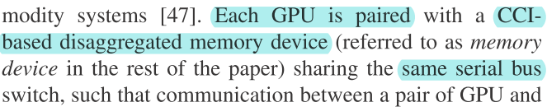
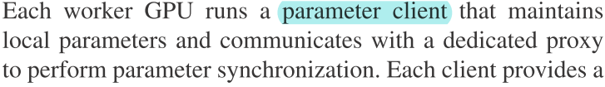
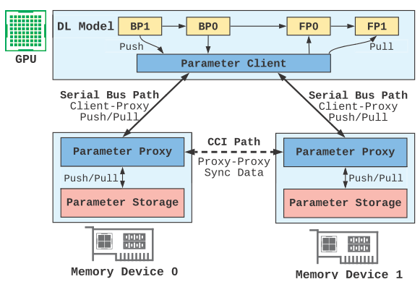
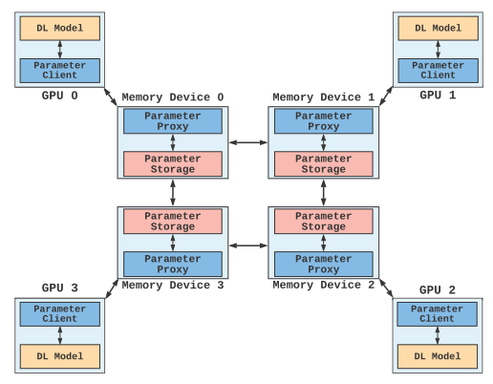
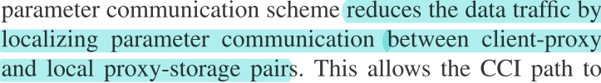
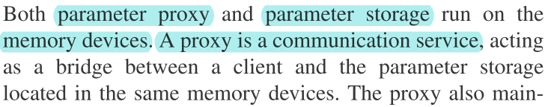
HPCA 2022: Enabling Efﬁcient Large-Scale Deep Learning Training with Cache Coherent Disaggregated Memory Systems
^{[M.1]}
III. Solutions
1. Decentralized parameter communication
“Cache cOherent interconnected pARameter Server (COARSE), which is a decentralized parameter synchronization design ofﬂoaded to CCI-based disaggregated memory systems.”
[M.1] https://cseweb.ucsd.edu/~jzhao/files/wang-hpca2022.pdf

Slide 3
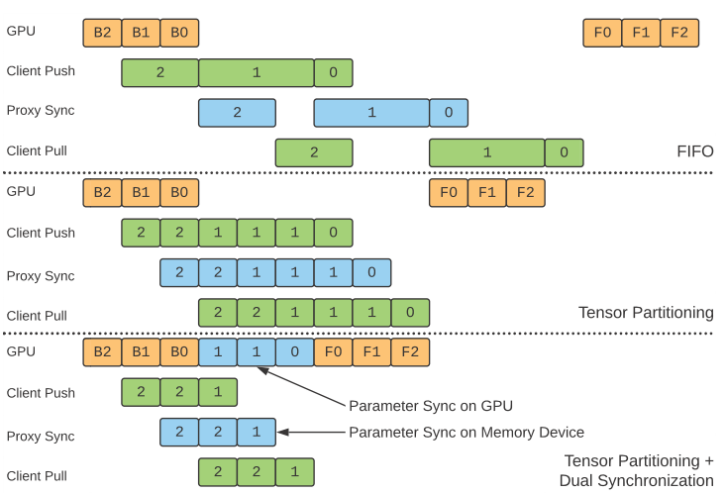
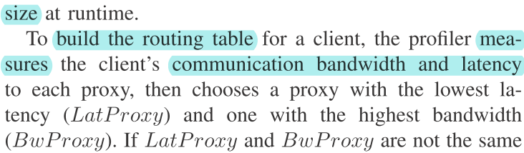
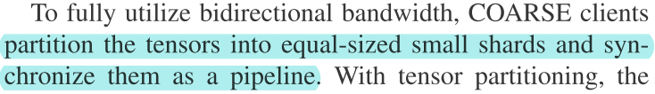
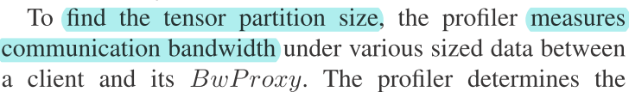
HPCA 2022: Enabling Efﬁcient Large-Scale Deep Learning Training with Cache Coherent Disaggregated Memory Systems
^{[M.1]}
III. Solutions
2. Tensor routing and partitioning
No single routing and partitioning of DL operations ﬁts all.
Small-size parameter communication is latency-critical because the communication does not saturate the serial bus bandwidth
Large-size parameters communication is bandwidth critical.
a tensor routing mechanism to exploit non-uniform parameter size and band-width distribution;
a tensor partitioning mechanism to exploit the bidirectional bandwidth offered by the serial bus interface
unequal-sized tensors, bidirectional transfer is not fully utilized: no client push/pull
[M.1] https://cseweb.ucsd.edu/~jzhao/files/wang-hpca2022.pdf

Slide 4
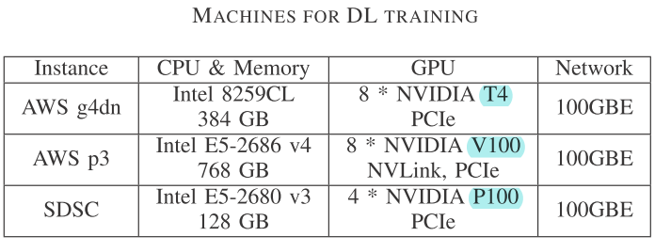
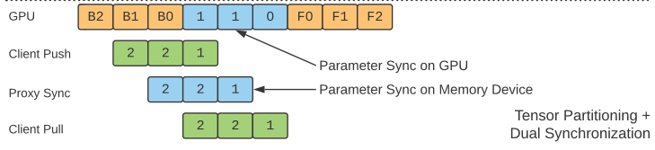
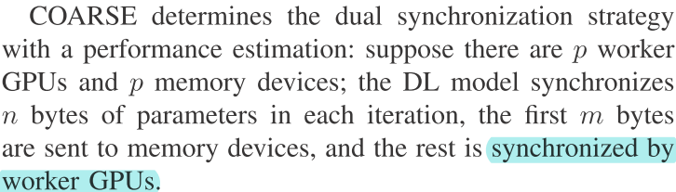
HPCA 2022: Enabling Efﬁcient Large-Scale Deep Learning Training with Cache Coherent Disaggregated Memory Systems
^{[M.1]}
III. Solutions
3. Dual synchronization
IV. Experiment and Results
(1) light communication trafﬁc, (2) high interconnection bandwidth utilization, (3) high GPU computation utilization.
In a DL backpropagation, tensors of the ﬁrst few layers are updated at the end of a training iteration while immediately consumed by the forward pass of the next iteration. These tensors need to be prioritized and synchronized as fast as possible to start the next iteration. To this end, COARSE adopts dual synchronization: the ﬁrst few layers’ tensors are synchronized by worker GPUs, while the rest layers’ tensors are pushed to proxies and synchronized by proxies.
Training Speedup | Comparing to baseline (AllReduce)
Single-node | 48.3% faster
Multi-node | 42.7% faster
Included in training time but it’s the time that blocks the training computation.
COARSE takes time to seek non-uniform bandwidth for faster communication, but T4 does not have such a bandwidth feature.
Similar results in multi-node system.
Communication Time¹ | Comparing to baseline (AllReduce)
T4 | 18-20% more²
P100 | 28.7% less
V100³ | 20-40-% less
* The design also include a queue-based synchronization scheme to prevent synchronization deadlocks.
[M.1] https://cseweb.ucsd.edu/~jzhao/files/wang-hpca2022.pdfc

Slide 5
HPCA 2022: Enabling Efﬁcient Large-Scale Deep Learning Training with Cache Coherent Disaggregated Memory Systems
^{[M.1]}
V. Related Work
COARSE: “the ﬁrst paper to explore the cache-coherent disaggregated memory system to accelerate communication in DL training.”
 | Related Work | COARSE
Parameter Server | A distributed parameter server design based on Ethernet [R.1] | Leverages cache-coherent interconnection
 | GeePS: a GPU-specialized parameter server that stores part of the parameters on GPU memory to speed up the parameter push/pull processes, which enables the multi-server-node training but limits to one GPU per node. [R.2] | Work with multiple GPUs per node
 | A parameter server with software-hardware co-design to optimize the rack-scale Ethernet latency. [R.3] | Reduce serial bus latency using cache-coherent interconnection
[M.1] https://cseweb.ucsd.edu/~jzhao/files/wang-hpca2022.pdfc
[R.1] https://web.eecs.umich.edu/~mosharaf/Readings/Parameter-Server.pdf
[R.2] https://www.pdl.cmu.edu/PDL-FTP/CloudComputing/GeePS-cui-eurosys16.pdf
[R.3] https://arxiv.org/abs/1805.07891

Slide 6
HPCA 2022: Enabling Efﬁcient Large-Scale Deep Learning Training with Cache Coherent Disaggregated Memory Systems
^{[M.1]}
V. Related Work
 | Related Work | COARSE
Speedup Communication in DL Training | ByteScheduler: a communication scheduler for DL training, which is beneﬁcial when using low bandwidth Ethernet communication, but provides less speedup when using intra-node serial buses for communication. [R.4] | Leverages CCI disaggregated memory to speed up the communication on fast serial buses and support large DL models
 | Blink: a collective communication scheme optimized for GPUs interconnected by both NVLink and PCIe, which runs parameter synchronization jobs on GPUs. [R.5] | Ofﬂoads parameter synchronization jobs to CCI memory devices to further improve GPU utilization.
 | An in-network accelerator for collective communication, and it does not support extended memory space for GPUs. [R.6] | A disaggregated memory extension for parameter communication.
 | Hop: a queue-based parameter synchronization in decentralized DL training, which leverages bounded staleness training. [R.7] | Target synchronized training and thus isorthogonal to [R.7]
 | Prague: a group-based AllReduce synchronization scheme for distributed DL training, which uses partial synchronization to achieve high performance. [R.8] | Provide full synchronization without losing precision
 | A hierarchical multi-level parameter server designed with GPU memory, CPU memory, SSD, and network. It relies on CPU-GPU communication to exchange parameters. [R.9] | Enable GPU direct access to CCI memory device to exploit full serial bus bandwidth.
[R.4] https://i.cs.hku.hk/~cwu/papers/yhpeng-sosp19.pdf
[R.5] https://arxiv.org/abs/1910.04940
[R.6] https://ieeexplore.ieee.org/document/9138924
[R.7] https://arxiv.org/abs/1902.01064
[R.8] https://dl.acm.org/doi/pdf/10.1145/3373376.3378499
[R.9] https://arxiv.org/abs/2003.05622
[M.1] https://cseweb.ucsd.edu/~jzhao/files/wang-hpca2022.pdfc

Slide 7
HPCA 2022: Enabling Efﬁcient Large-Scale Deep Learning Training with Cache Coherent Disaggregated Memory Systems
^{[M.1]}
V. Related Work
 | Related Work | COARSE
Disaggregated Memory | A memory disaggregation architecture with a memory blade connected over PCIe to expand CPU accessible memory. [R.10, R.11] | Explore the potential of disaggregated memory using CCI.
 | A memory network for GPU and CPU using packet routing from hybrid memory cubes. [R.12] | Not rely on speciﬁc memory media technology
 | A memory-centric architecture for distributed DL training, which assumes uniﬁed communication bandwidth in serial bus. [R.13] | Exploit the non-uniform bandwidth
 | Related Work | COARSE
Near Memory Processing for DL Training | Tensor-DIMM: a near memory processing design to ofﬂoad embedding operations in recommendation systems, which accelerates the specialized operations. [R.14] | Provide generic acceleration to parameter synchronization operations.
 | iSwitch: a parameter synchronization design in Ethernet switch memory, which is beneﬁcial to reinforcement learning where model size is small enough to ﬁt in switch memory.[R.15] | Target large models and provides extended parameter storage.
[R.10] https://web.eecs.umich.edu/~twenisch/papers/isca09-disaggregate.pdf
[R.11] https://web.eecs.umich.edu/~twenisch/papers/hpca12-disagg.pdf
[R.12] https://dl.acm.org/doi/pdf/10.1109/MICRO.2014.55
[R.13] https://arxiv.org/abs/1902.06468
[R.14] https://arxiv.org/abs/1908.03072
[R.15] https://jianh.web.engr.illinois.edu/papers/iswitch-isca2019.pdfs
[M.1] https://cseweb.ucsd.edu/~jzhao/files/wang-hpca2022.pdfc

Slide 8
COARSE in the Mind Map of HPC (DL)
^{[M.1]}
Low bandwidth Ethernet communication [R.4]
HPC
Communication
Collective communication by NVLink and PCIe [R.5]
DL
Collective communication without extend space [R.6]
…
Memory
…
Queue-based, leveraging bounded staleness training [R.7]
COARSE: CCI based, disaggregated [M.1]
Partial synchronization [R.8]
Parameter server
CPU-GPU communication [R.9]
Distributed, base on ethernet [R.1]
Connect over PCIe, expand CPU accessible memory [R.10, R.11]
In Ethernet switch memory, small size model [R.15]
For rack-scale ethernet latency [R.3]
Packet routing from hybrid memory cubes[R.12]
Ofﬂoad embedding operations in recommendation systems [R.14]
GPU specialized, one GPU per node [R.2]
Uniﬁed communication bandwidth [R.13]

